Slide 1


Presentation on
Capstone Project
Shop For Home
Group members :
Anil Sadashiv Shinde
Bankupalli Sri Kavya
Naimesha Lekya Kondapalli
Shaik Charuk
Pudari Dinesh Yogi
Mentor Name :
Mr.Neeraj Kumar kheria.

Slide 2
Problem Statement
Shop For Home is a popular Store in the market for shopping the home décor stuff . Due to Covid19 all the offline shopping stopped. So, the store wants to move to the cloud platforms and wants their own web application.

Slide 3

User Stories
01
Login/ Logout/ Register
02
Cetegories
As a user I should be able to login, Logout into the application.
As a new user I should be able to register into the application
As a user I should be able to see the products in different categories.
As a user I should be able to sort the products.
03
Cart
04
Wishlist
As a user I should be able to add the products into the shopping cart.
As a user I should be able to increase or decrease the quantity added in the cart
As a user I should be able to increase or decrease the quantity added in the cart.
As a user I should be able to get the Wishlist option where I can add those products which I want but don’t want to order now.
As a user I should get different discount coupons..

Slide 4

Admin Stories
01
Login/ Logout/ Register
02
CRUD
As an Admin I should be able to login, Logout and Register into the application.
As an Admin I should be able to perform CRUD on Users.
As an Admin I should be able to Perform CRUD on the products.
03
Actions
04
Bulk upload
As an Admin I should be able to get the stocks.
As an Admin I should be able to mail if any stock is less than 10.
As an Admin I should be able to get the sales report of a specific duration
As an Admin I should be able to get bulk upload option to upload a csv for products details
As a Admin I should be able to make admin someone

Slide 5





Technologies used
Angular Framework
Spring Boot
Visual Studio Code
MySQL
Amazon Web Services

Slide 6
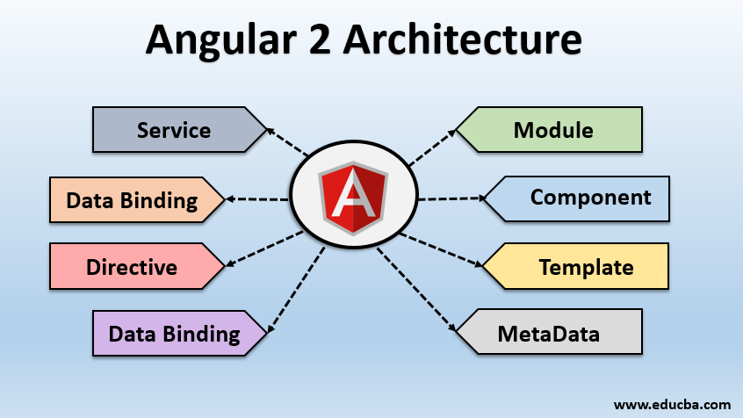
Angular Component Structure

Slide 7
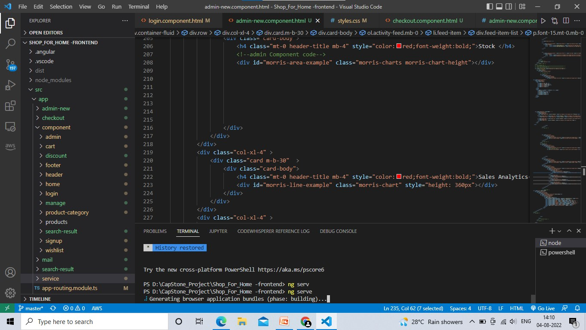
Angular Component Structure

Slide 8
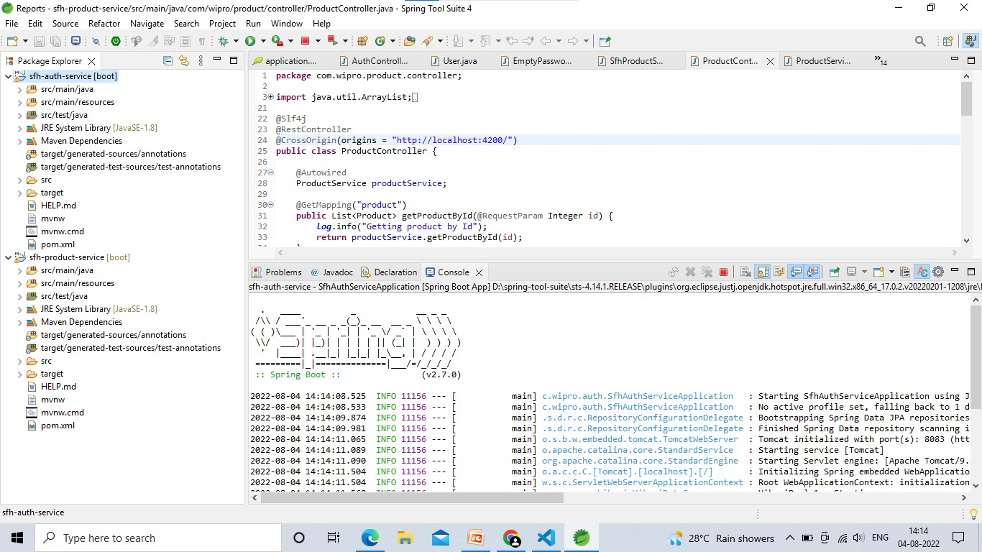
SpringBoot Microservice Stucture

Slide 9
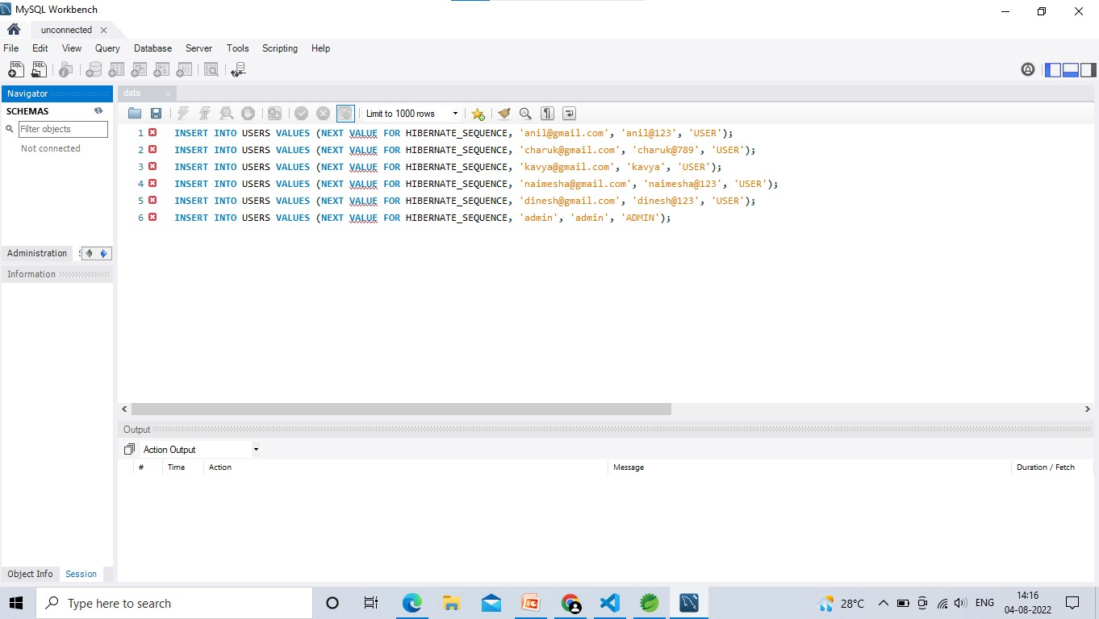
MySQL Database – User Microservice

Slide 10
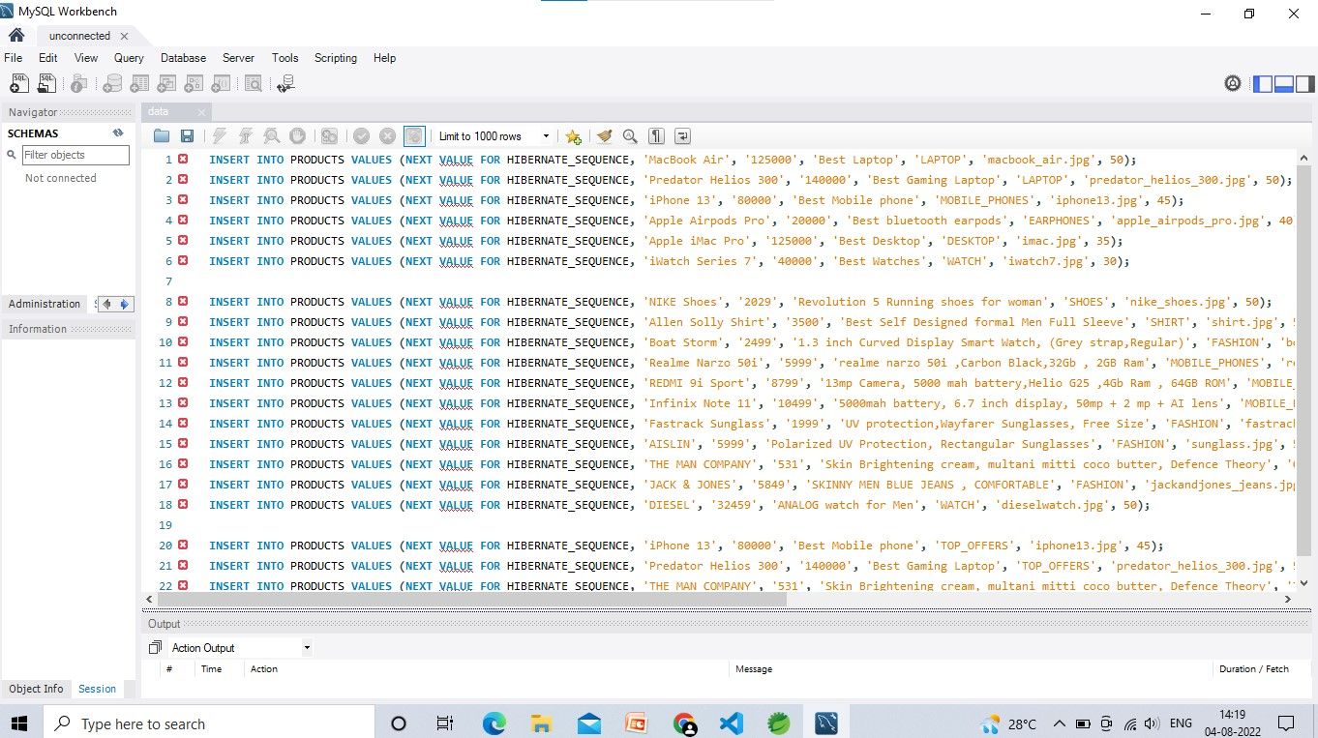
MySQL Database – Products Microservice

Slide 11
Interface
Admin dashboard
Mail
Manage Products
Manage Users
View Sales Report
User
Admin
User dashboard
Discount
wishlist
Cart
checkout

Slide 12
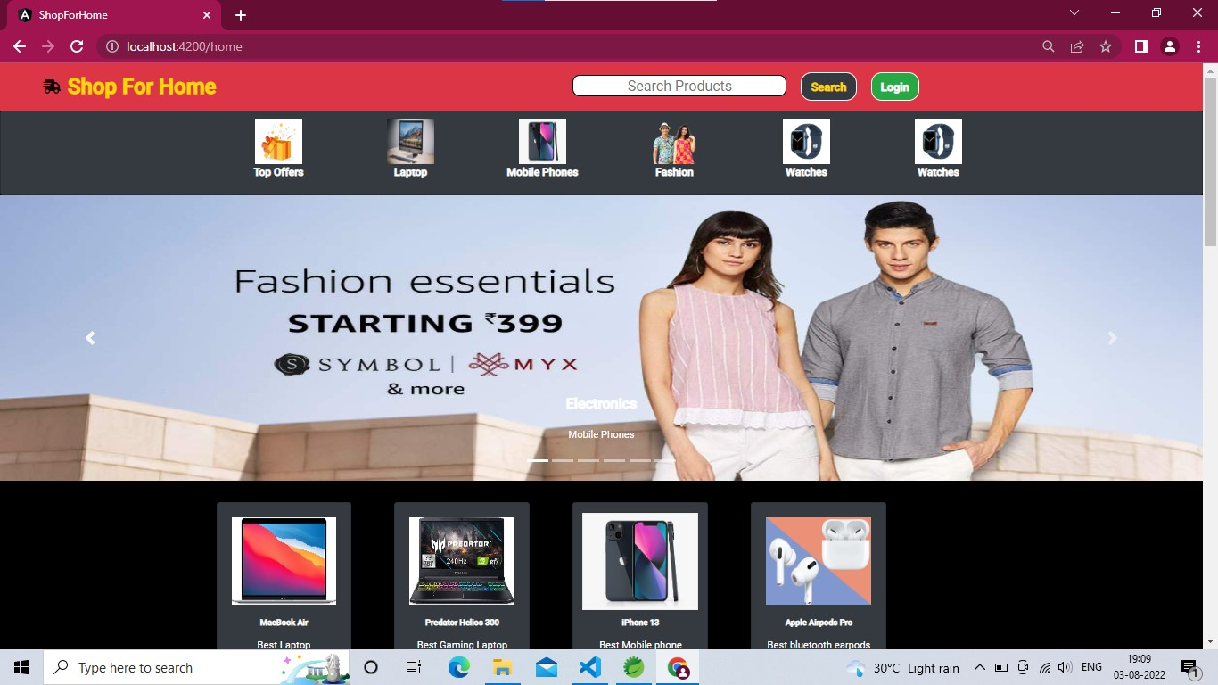
User Interface
Home Page

Slide 13
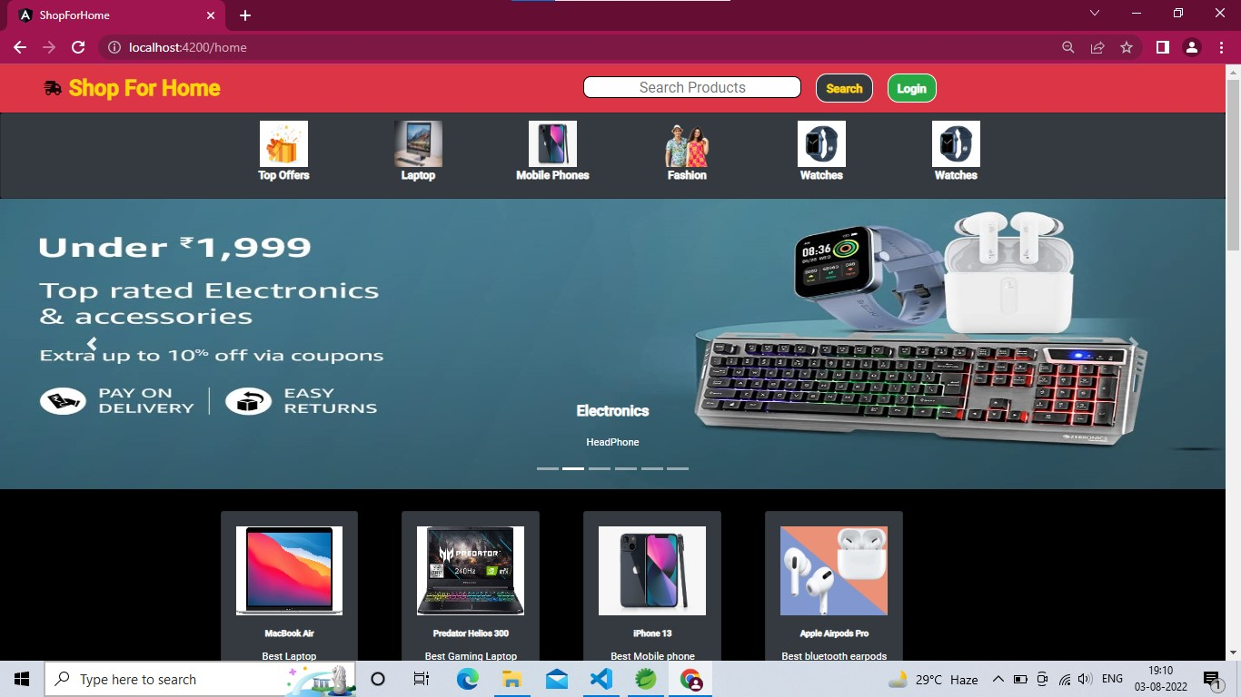
User Interface
Home Page

Slide 14
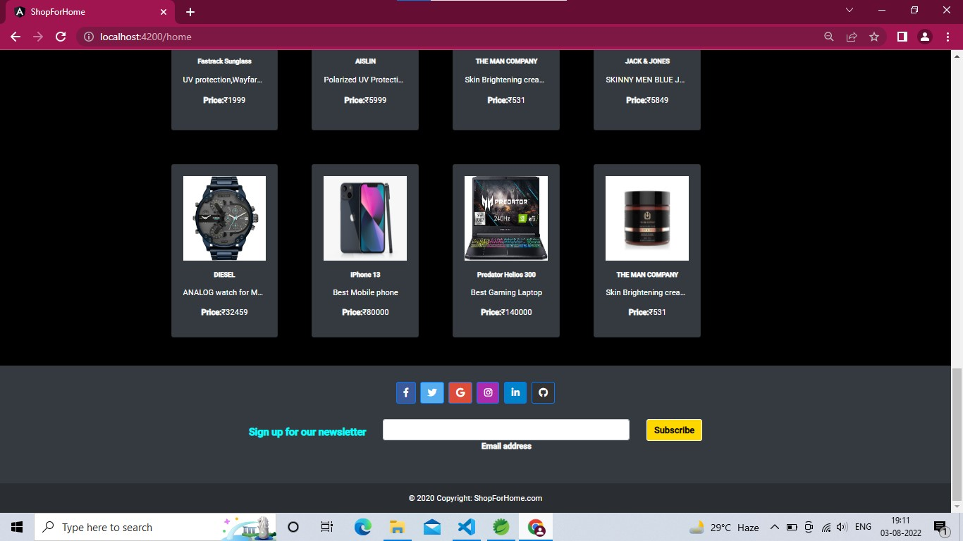
User Interface
Footer

Slide 15
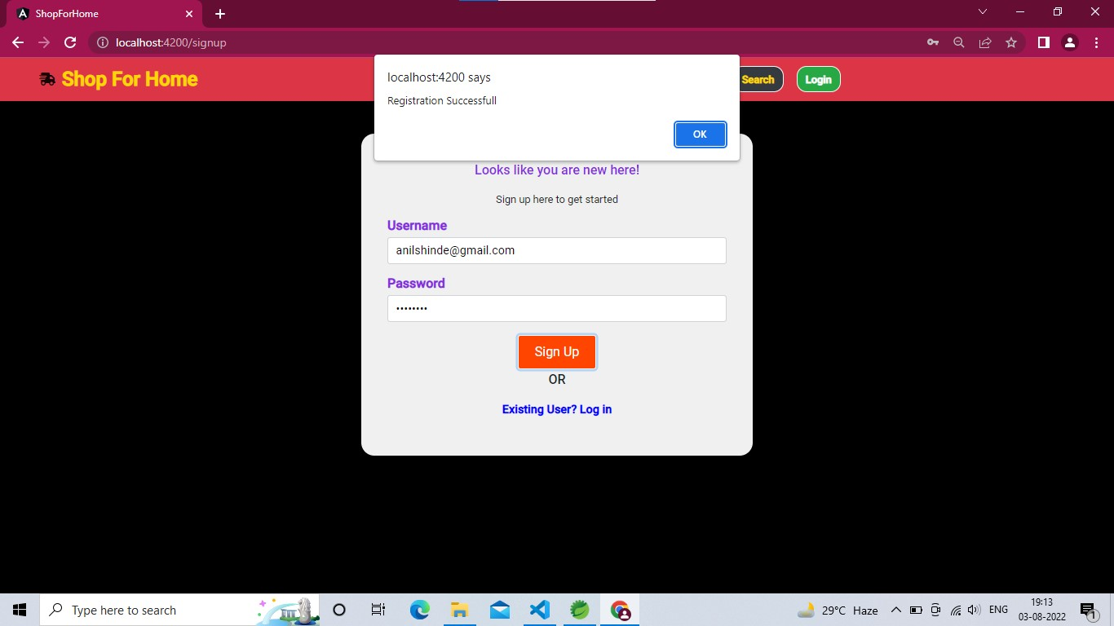
User Interface
signUp Page

Slide 16
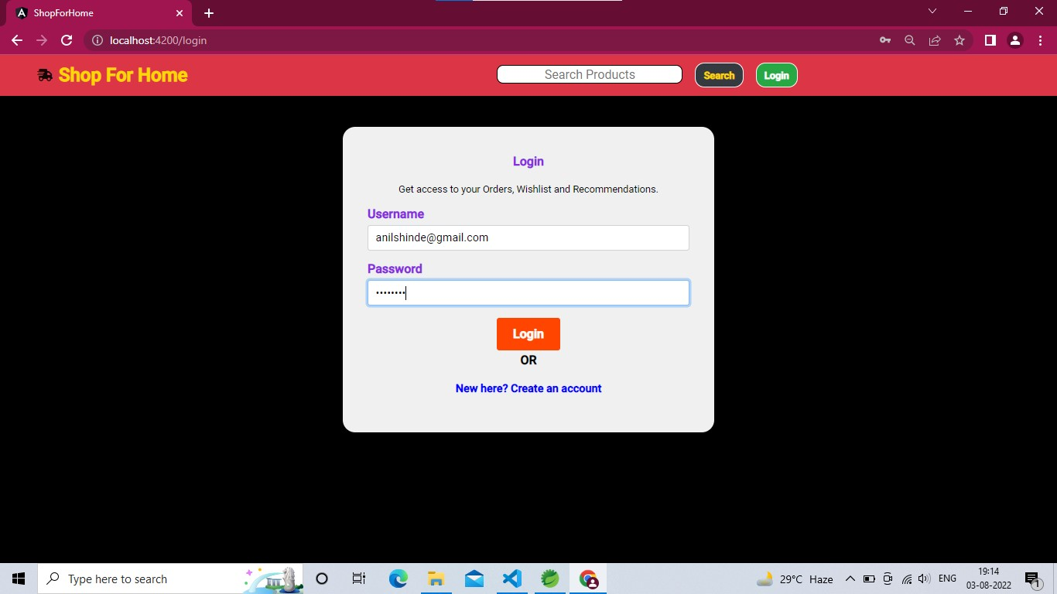
User Interface
Login Page

Slide 17
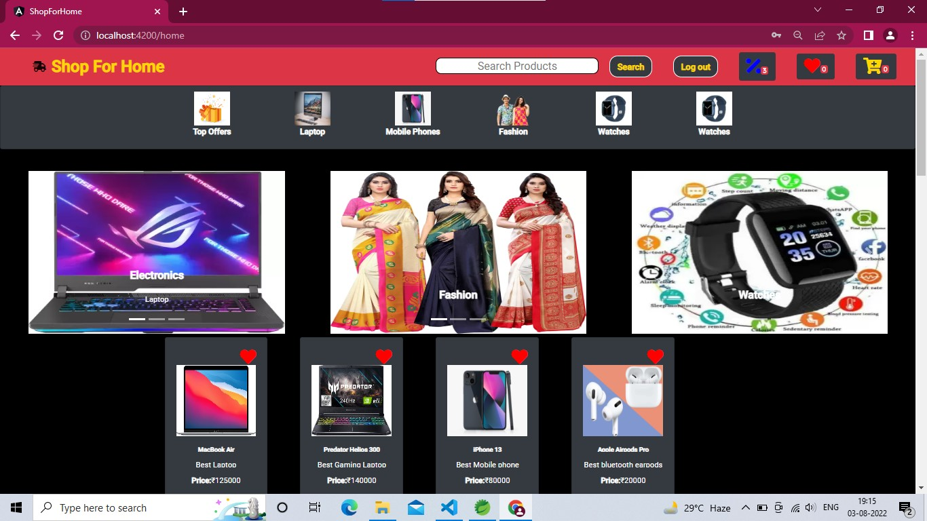
User Interface
User Dashboard

Slide 18
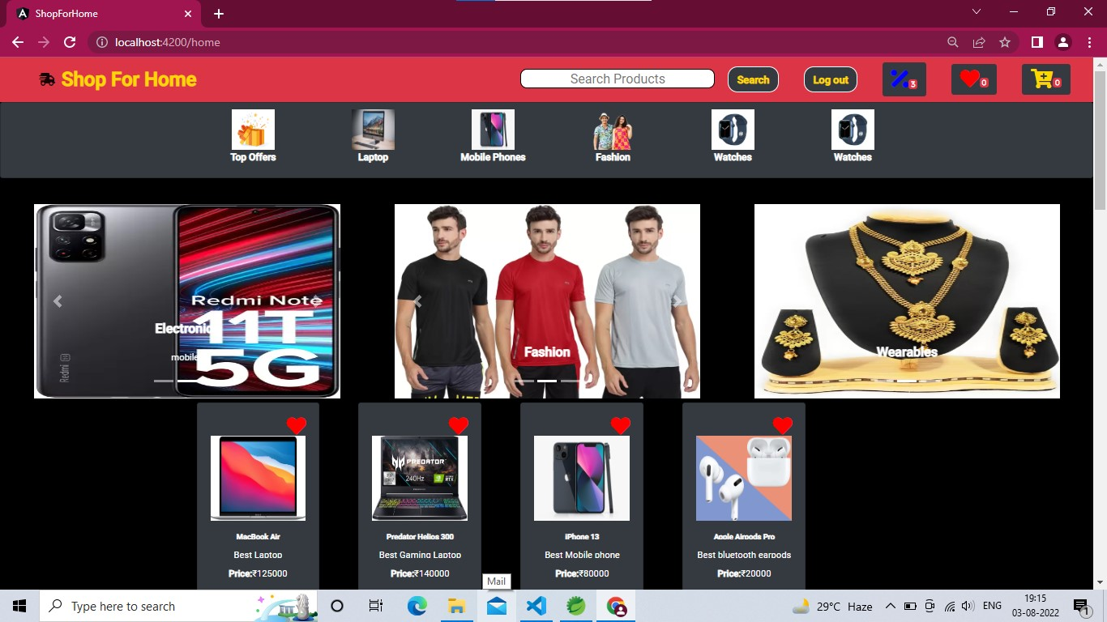
User Interface
User Dashboard

Slide 19
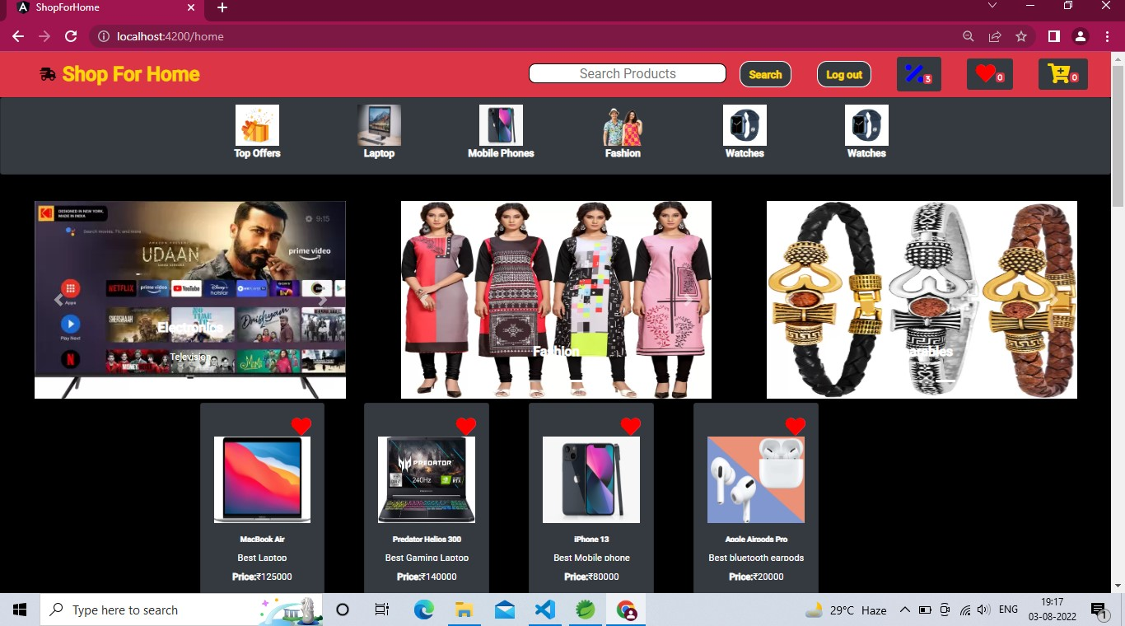
User Interface
User Dashboard

Slide 20
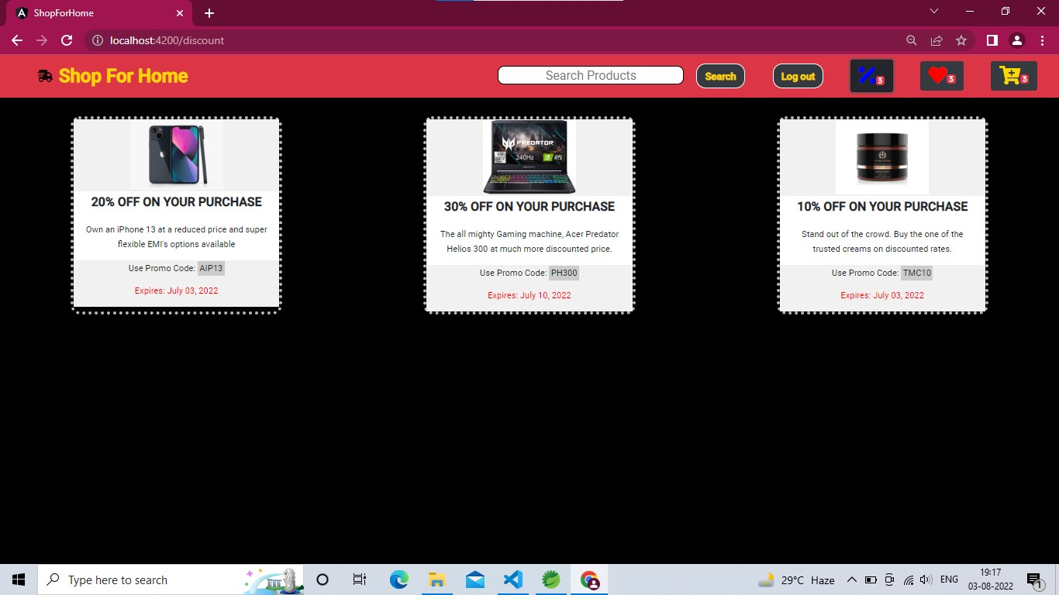
User Interface
Discount Page

Slide 21
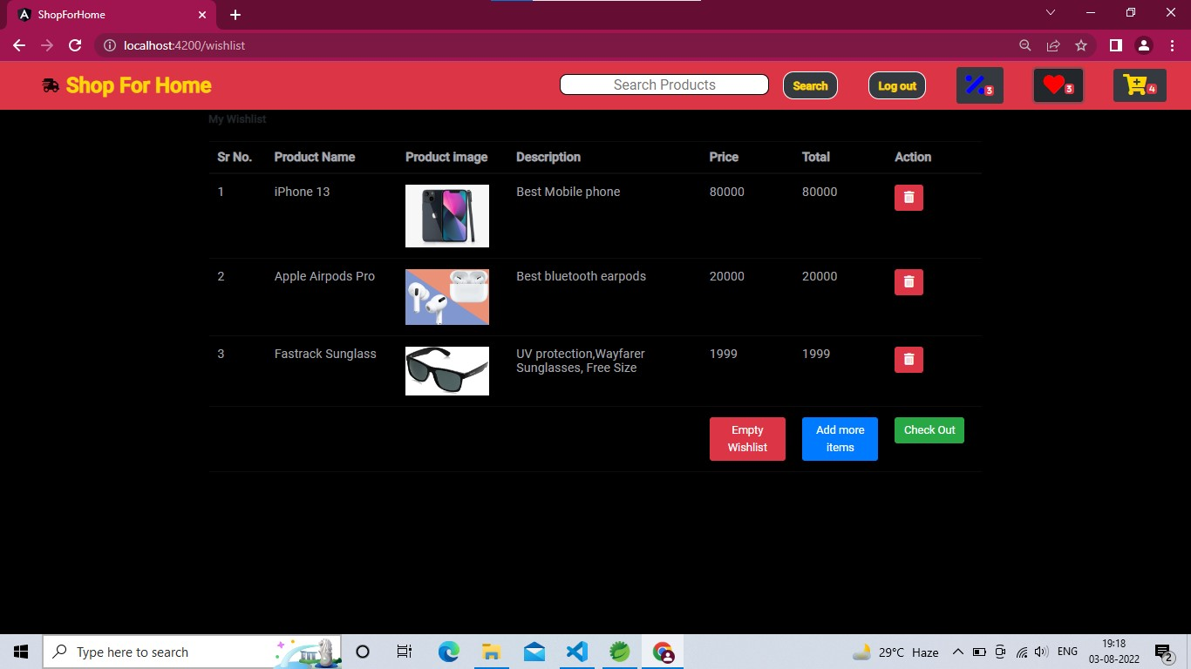
User Interface
User Wishlist

Slide 22
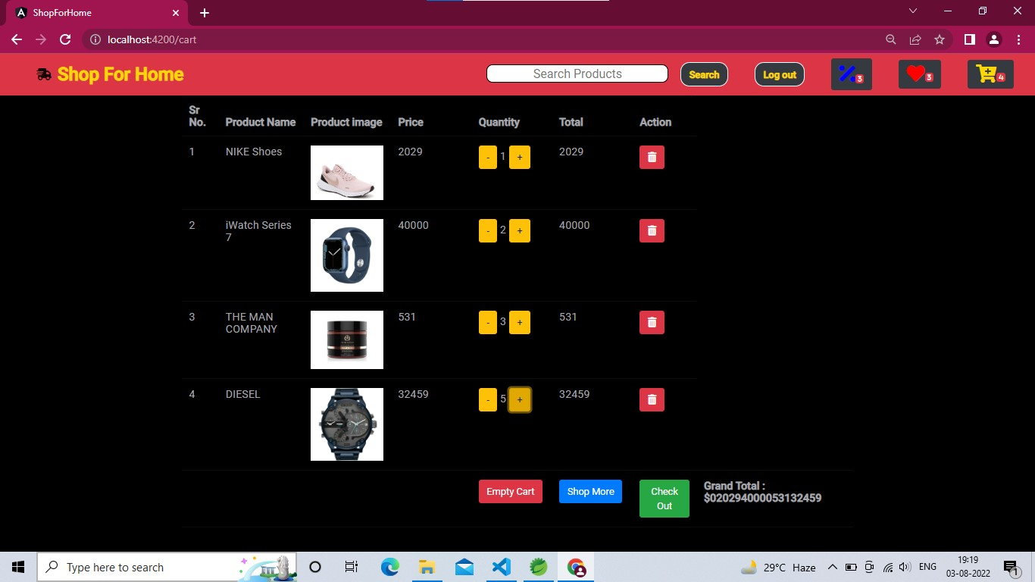
User Interface
User Cart

Slide 23
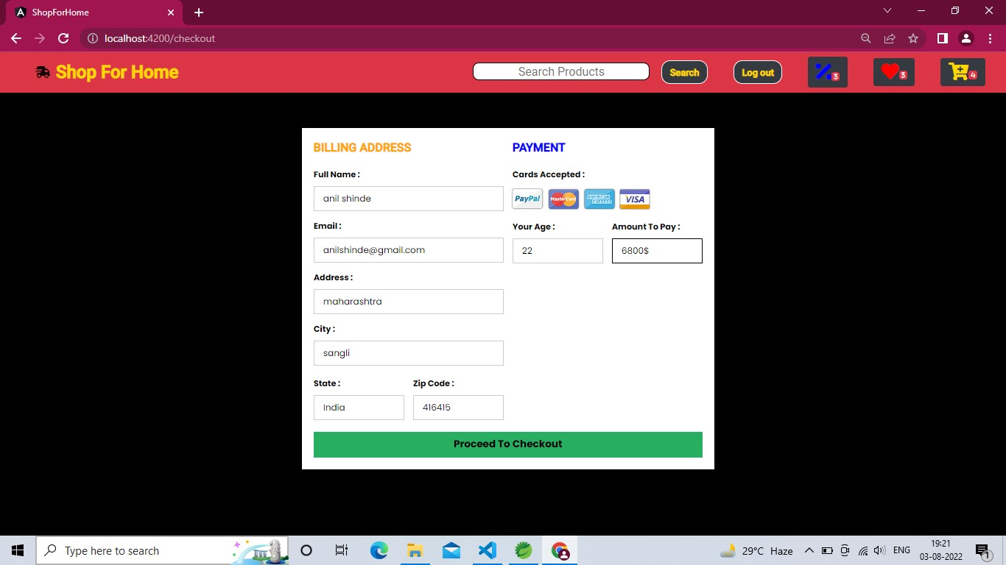
User Interface
Checkout page

Slide 24
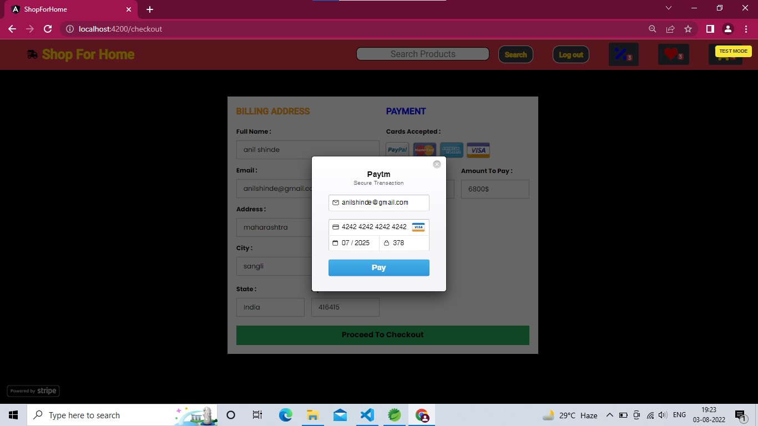
User Interface
Checkout page

Slide 25
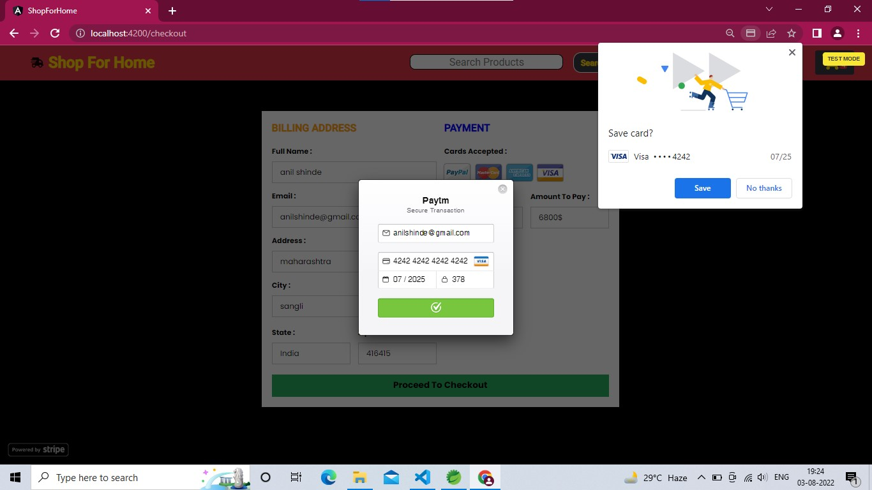
User Interface
Checkout page

Slide 26
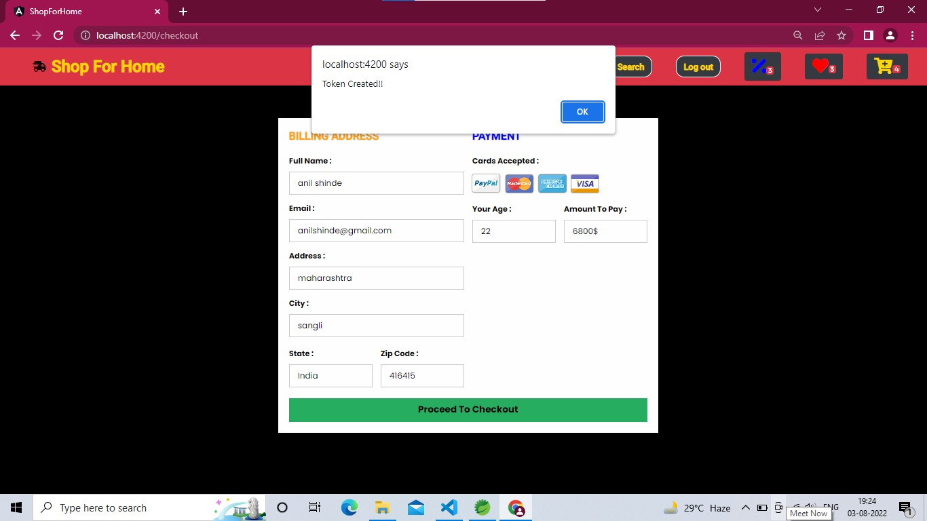
User Interface
Checkout page

Slide 27
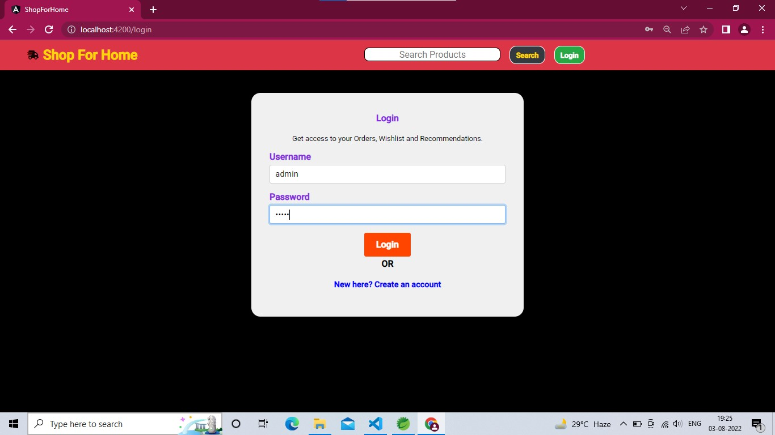
Admin Interface
Login page

Slide 28
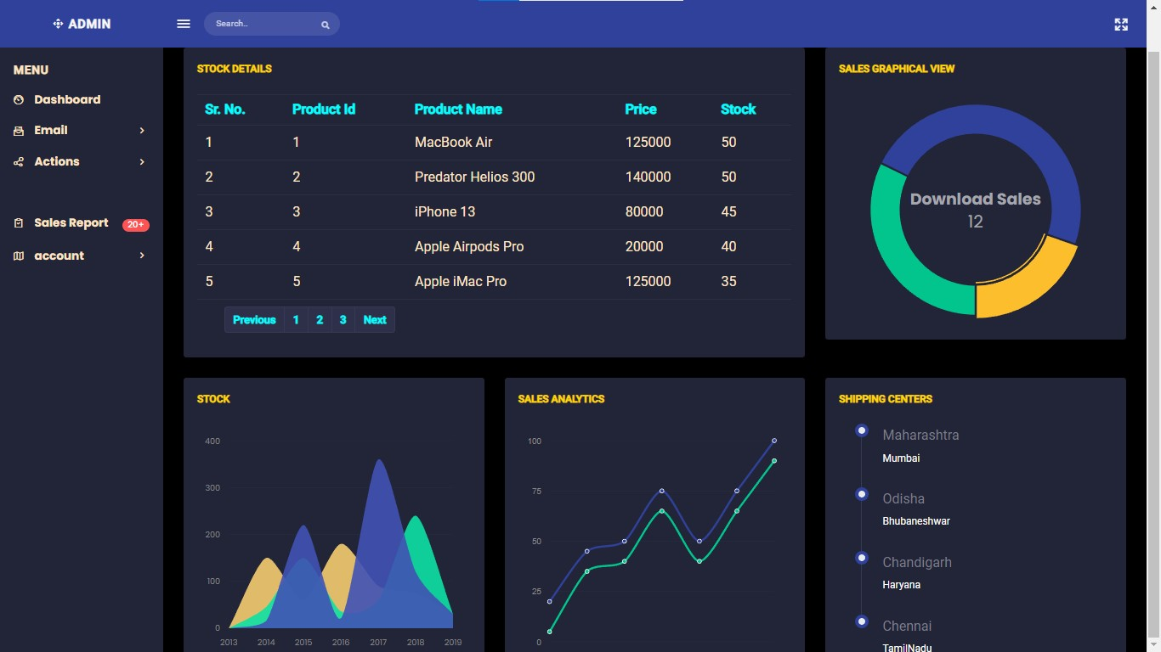
Admin Interface
Admin Dashboard

Slide 29
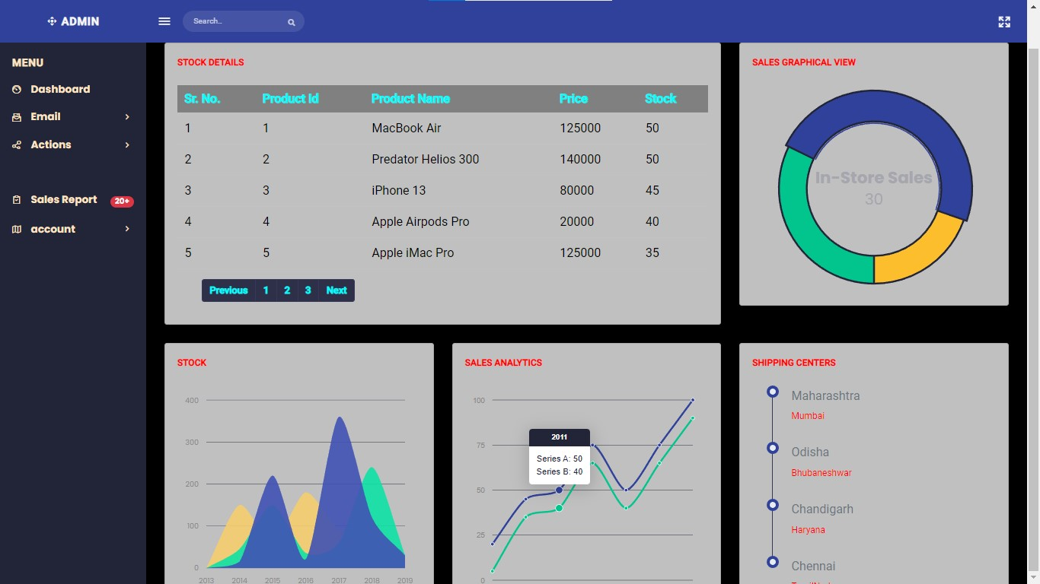
Admin Interface
Admin Dashboard

Slide 30
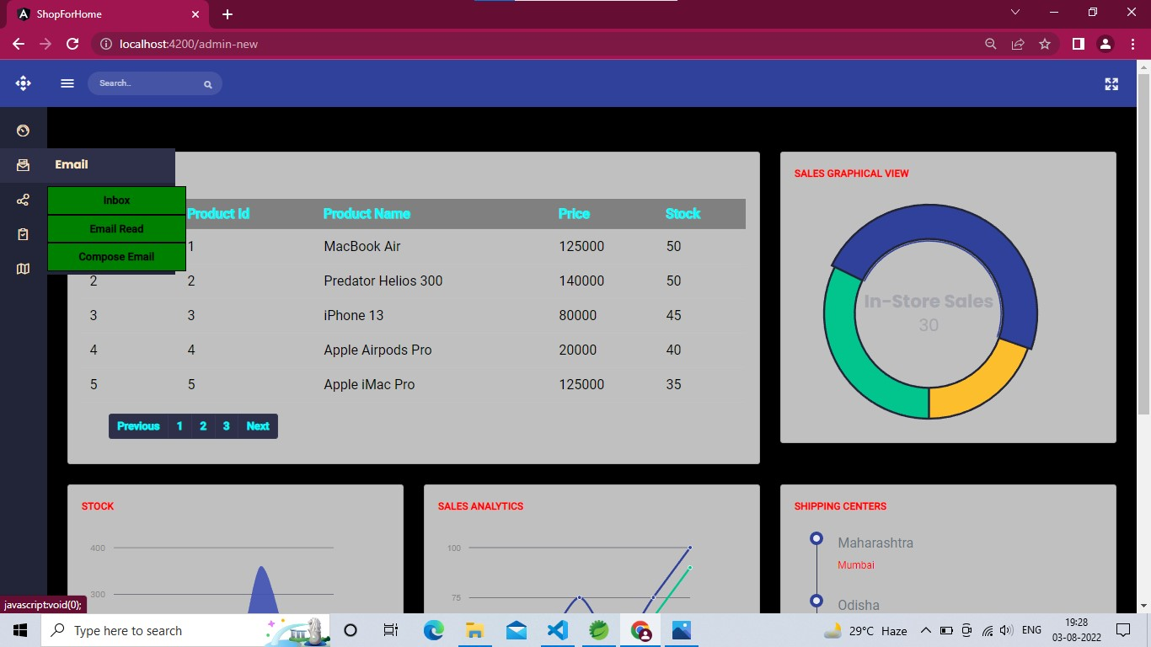
Admin Interface
Admin Options

Slide 31
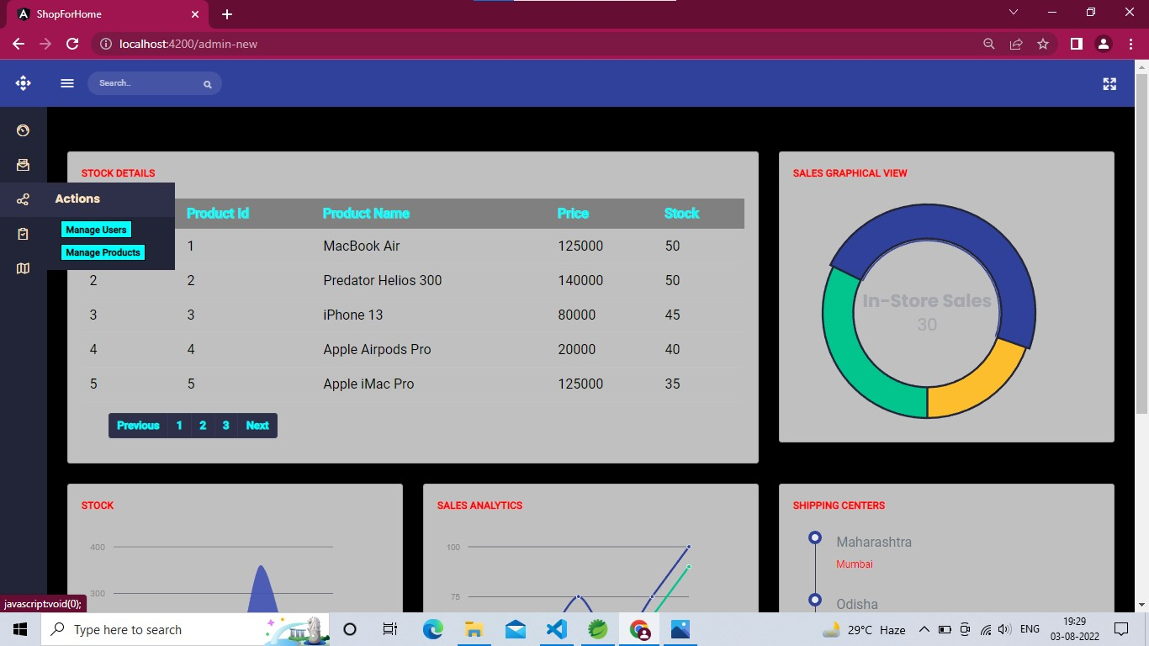
Admin Interface
Admin Options

Slide 32
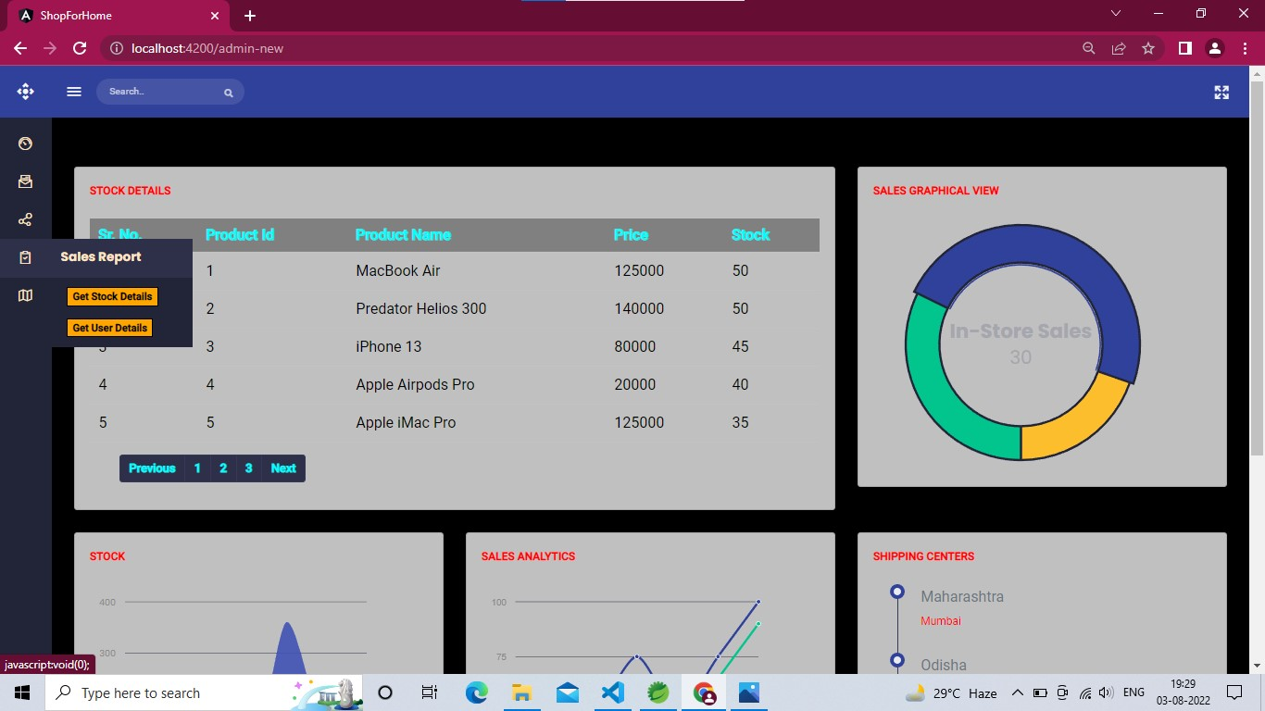
Admin Interface
Admin Options

Slide 33
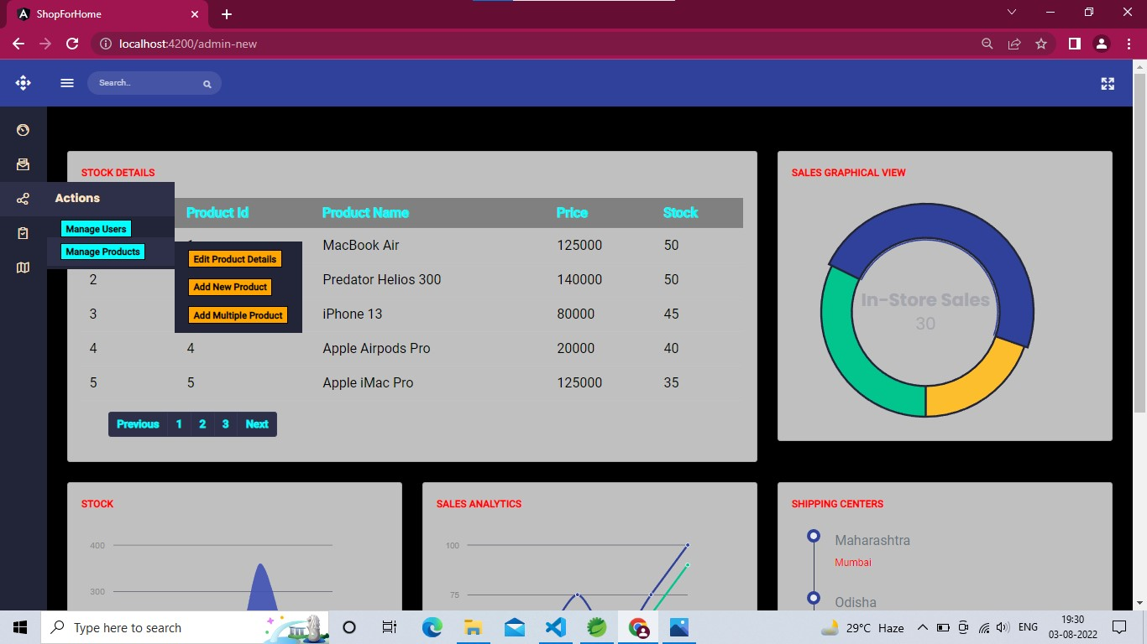
Admin Interface
Admin Options

Slide 34
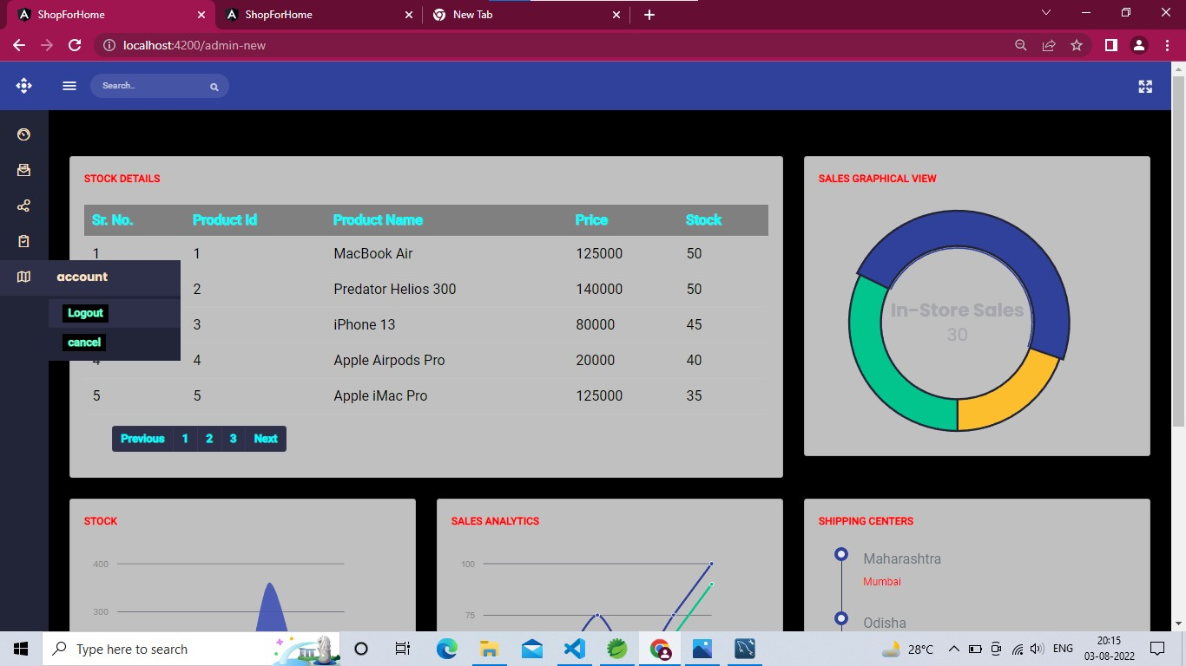
Admin Interface
Admin Options

Slide 35
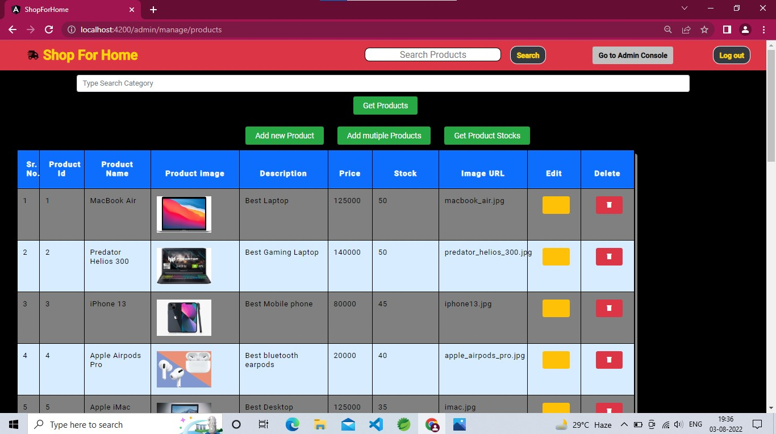
Admin Interface
Manage Products

Slide 36

Admin Interface
Search Products

Slide 37
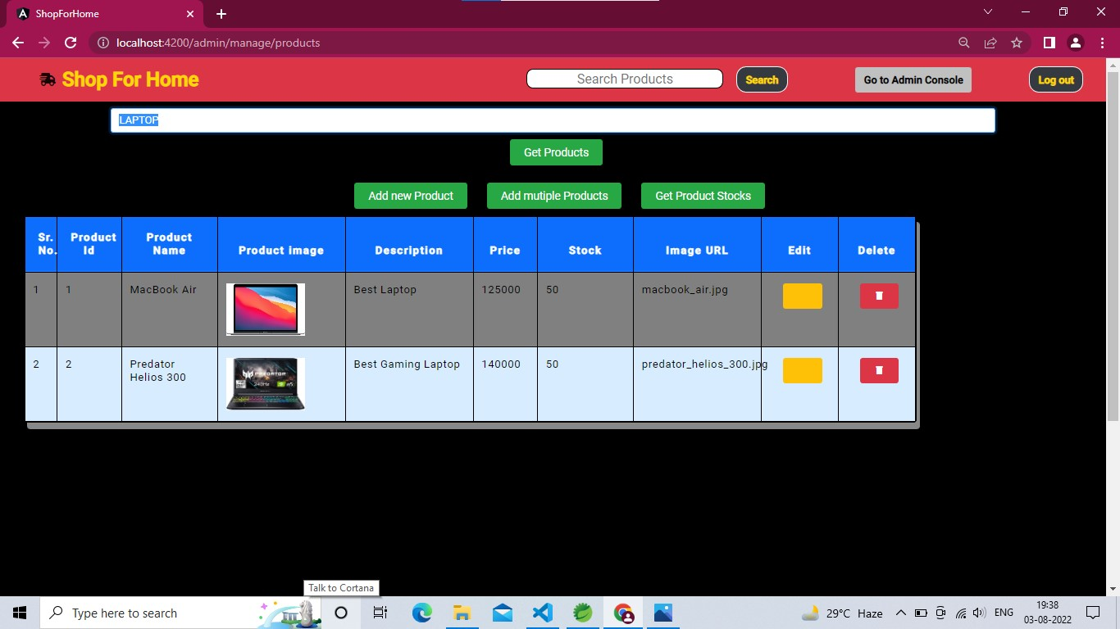
Admin Interface
Search Products

Slide 38
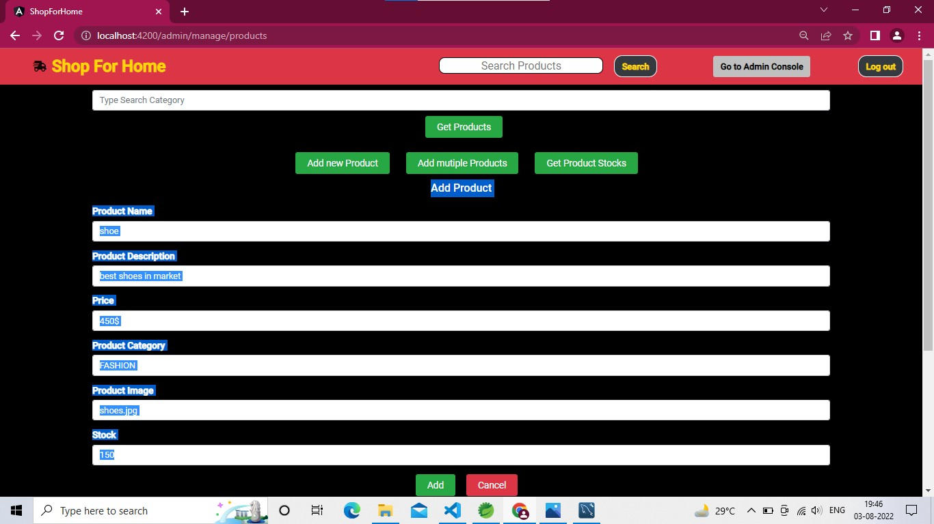
Admin Interface
Add New Product

Slide 39
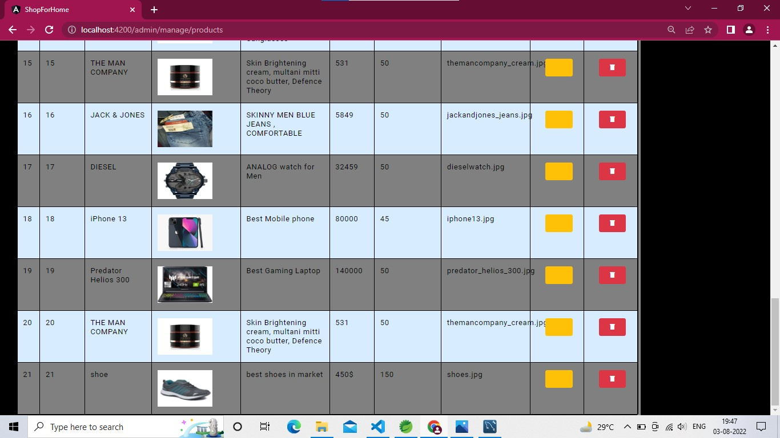
Admin Interface
Add New Product

Slide 40
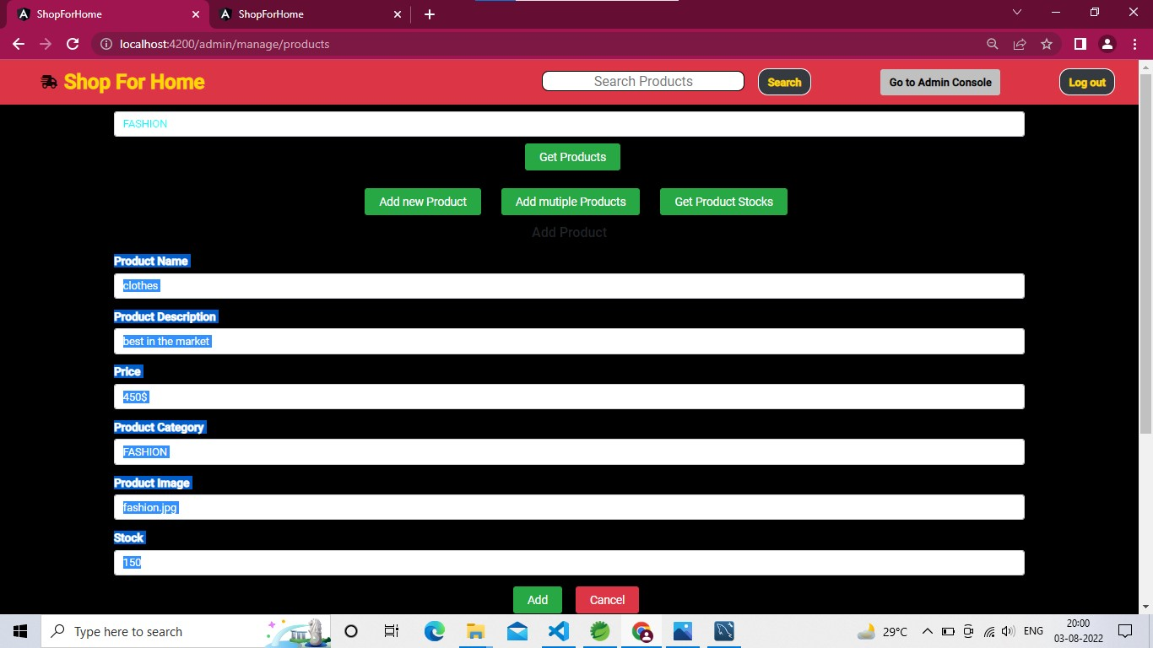
Admin Interface
Add New Product

Slide 41
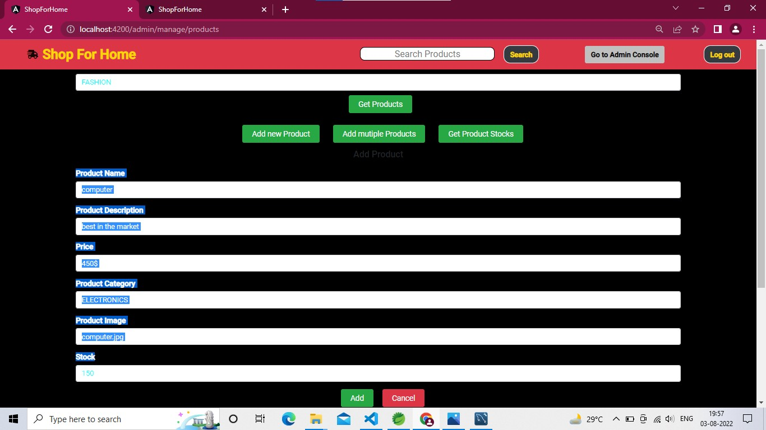
Admin Interface
Add New Product

Slide 42
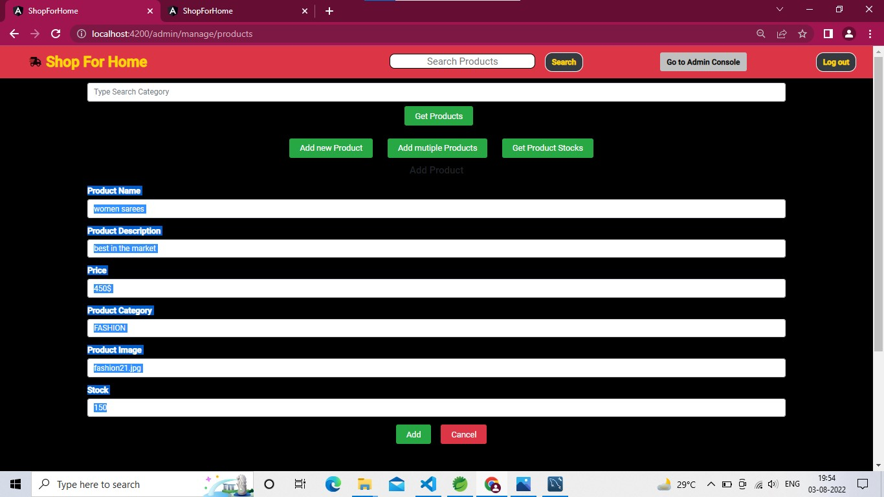
Admin Interface
Add New Product

Slide 43
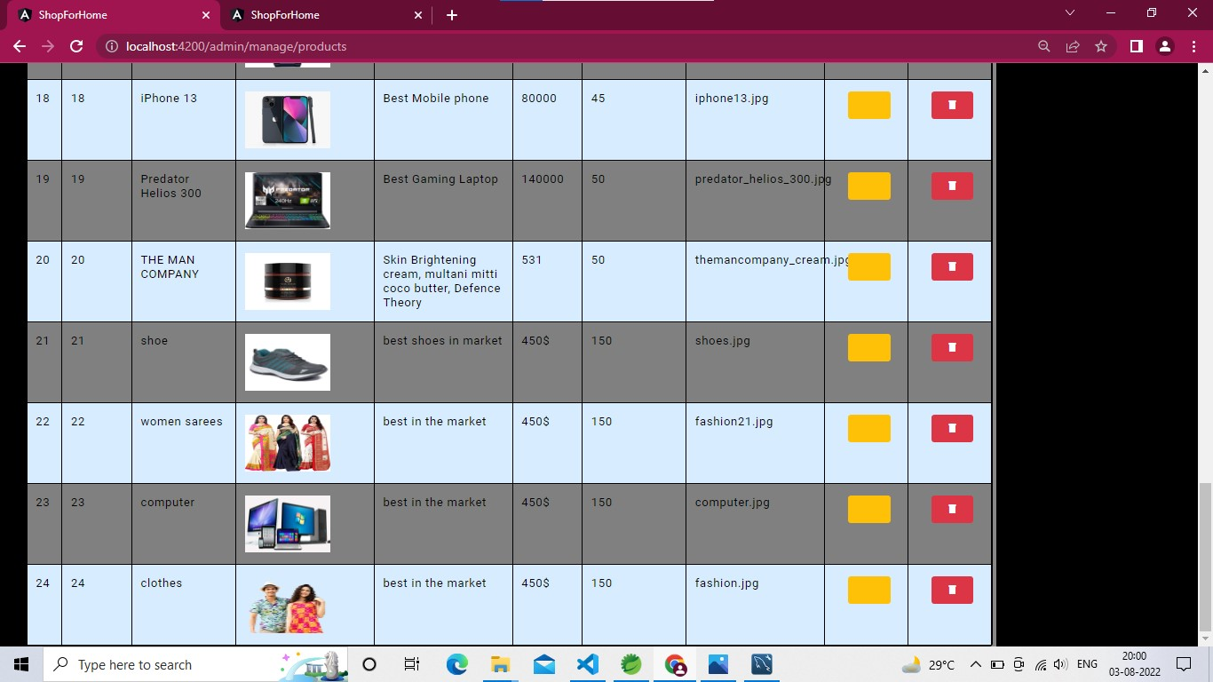
Admin Interface
Add New Product

Slide 44
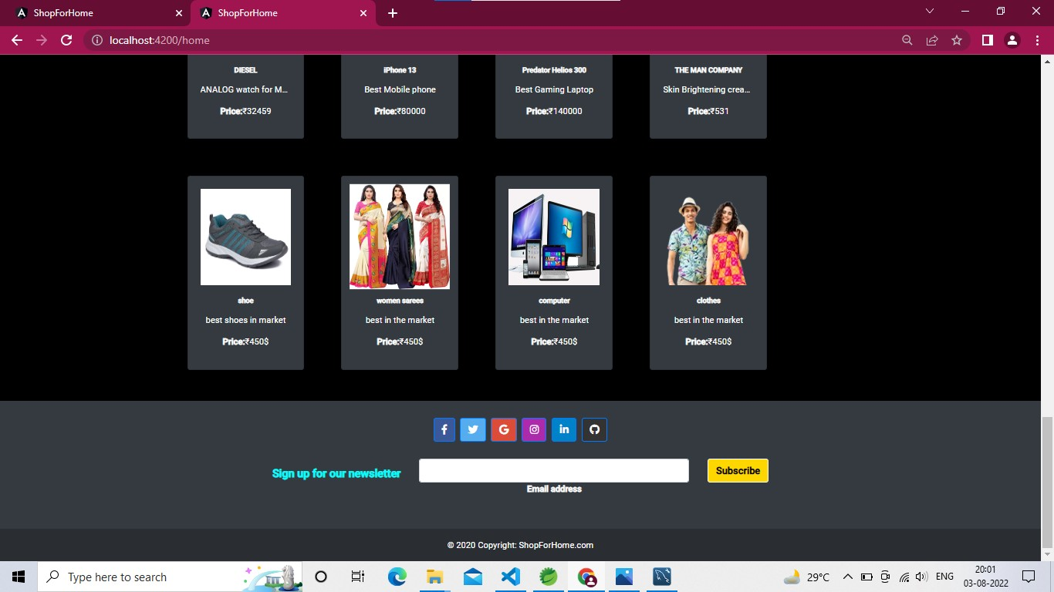
Admin Interface
Add New Product

Slide 45
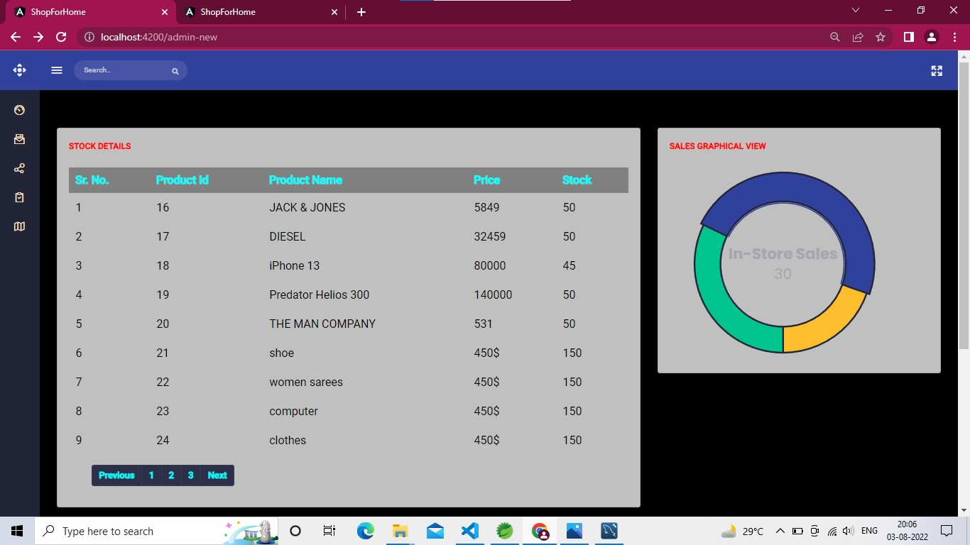
Admin Interface
Add New Product

Slide 46
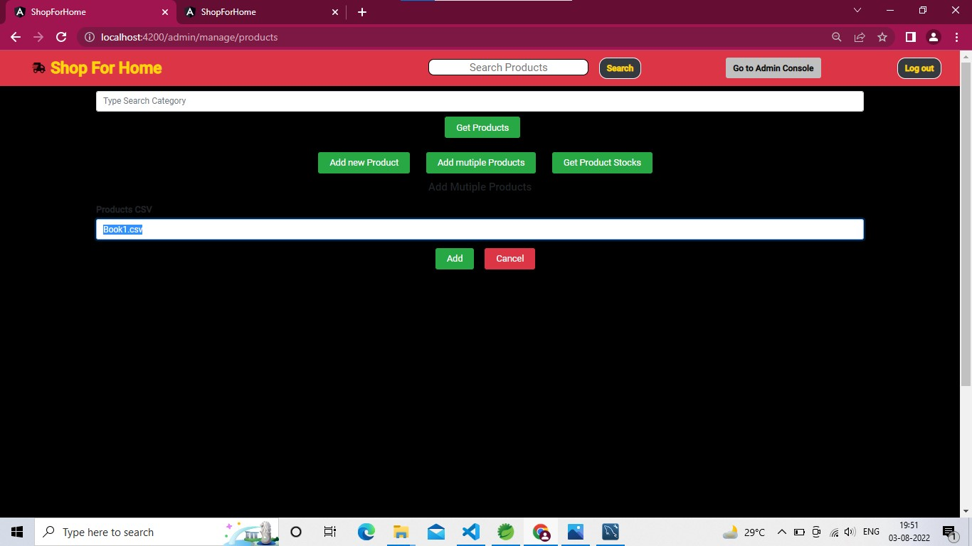
Admin Interface
Add Multiple products

Slide 47
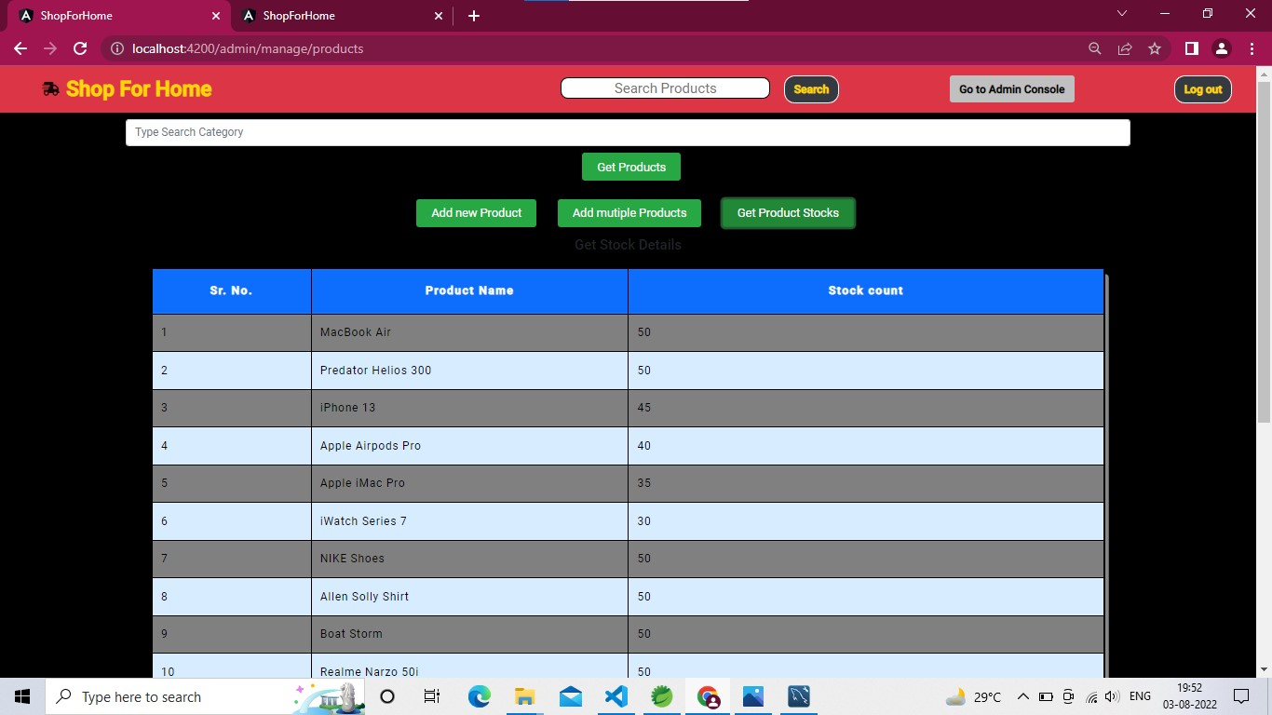
Admin Interface
Get Stock Details

Slide 48
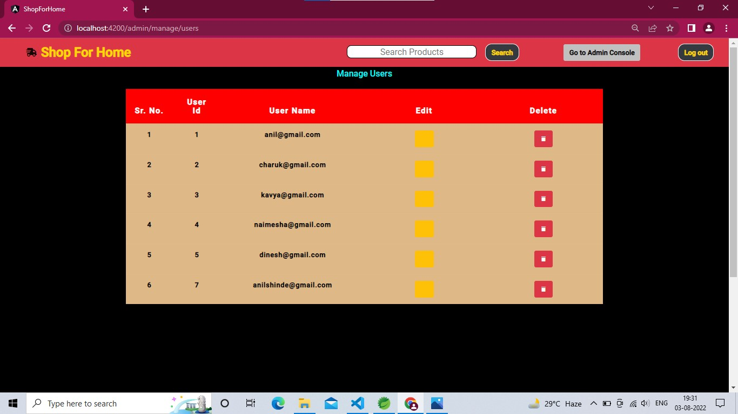
Admin Interface
Manage Users

Slide 49
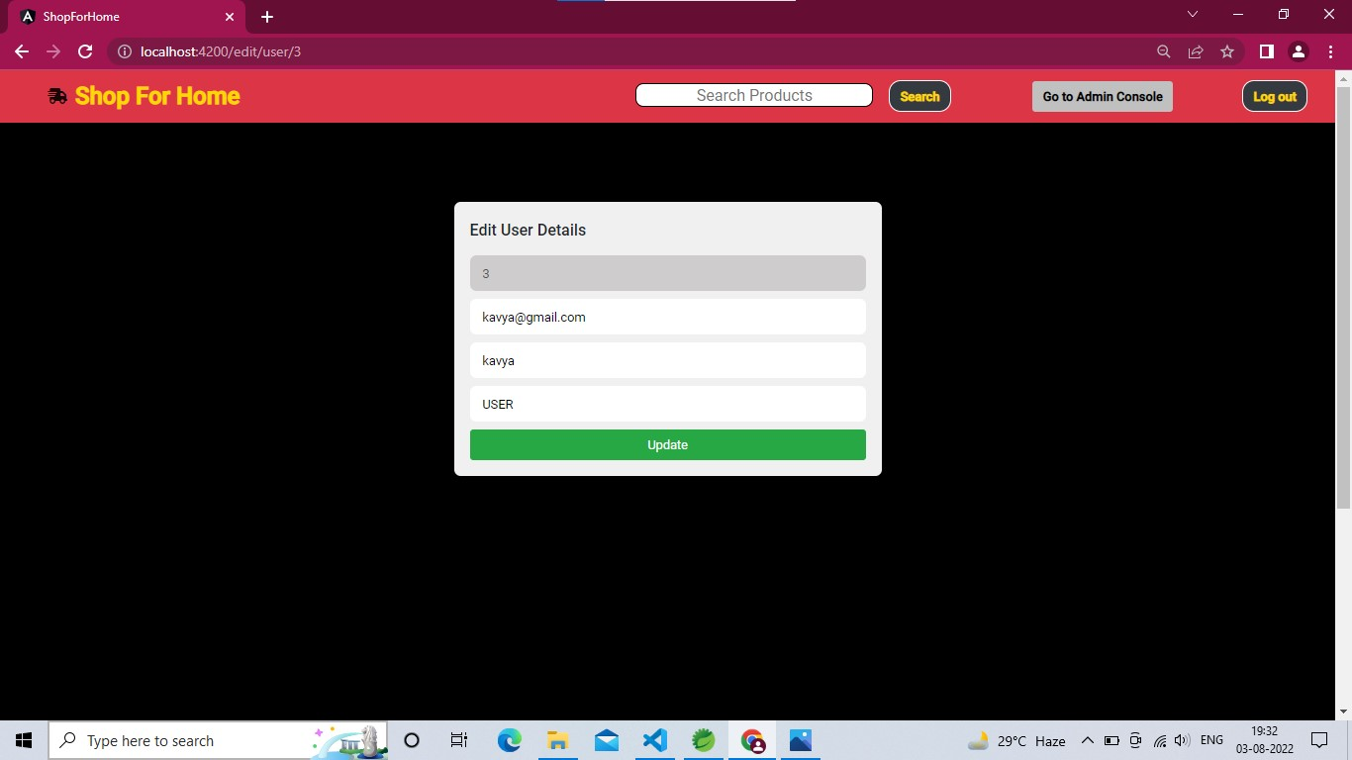
Admin Interface
Manage Users

Slide 50
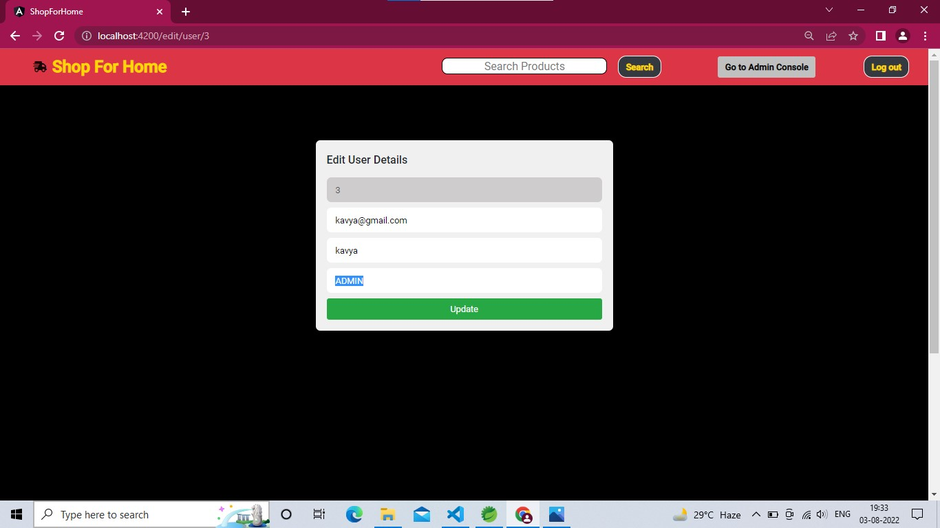
Admin Interface
Manage Users

Slide 51
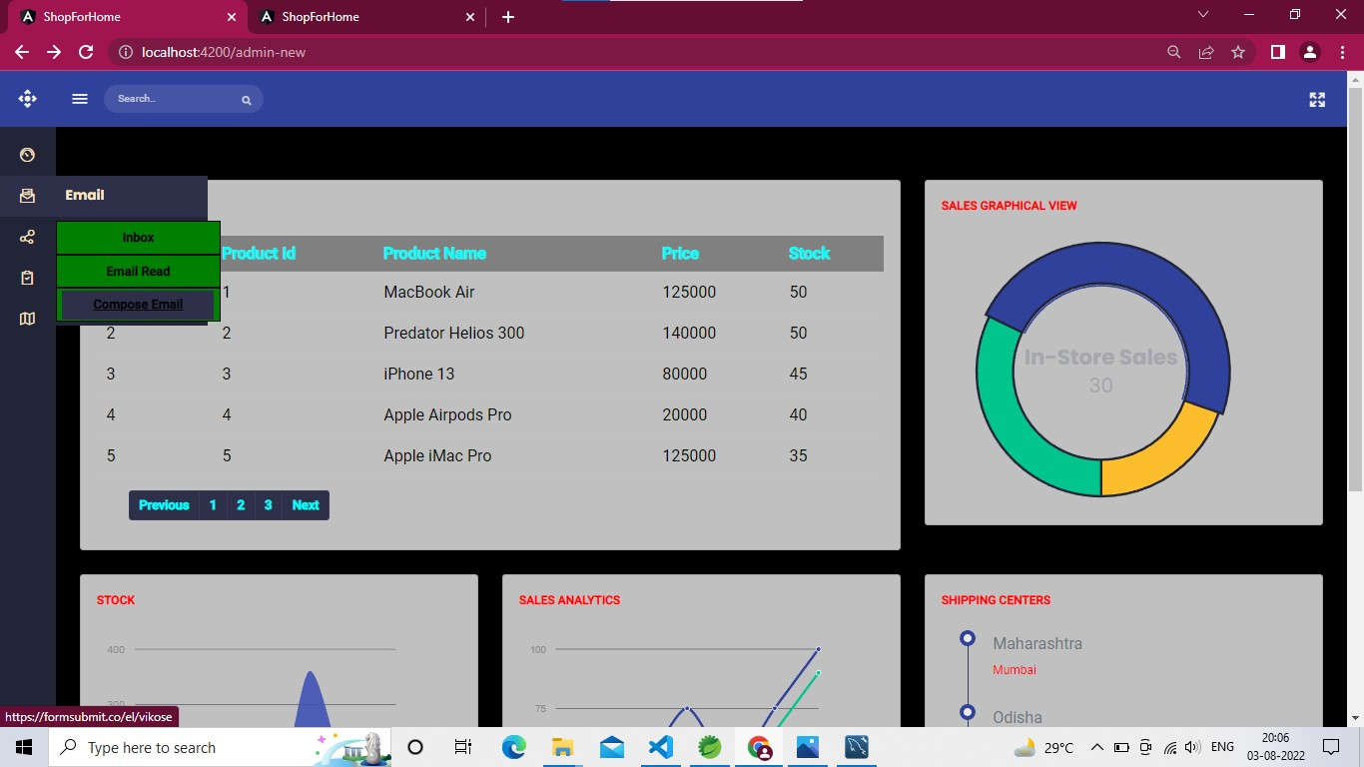
Admin Interface
Mail when stock < 10%

Slide 52
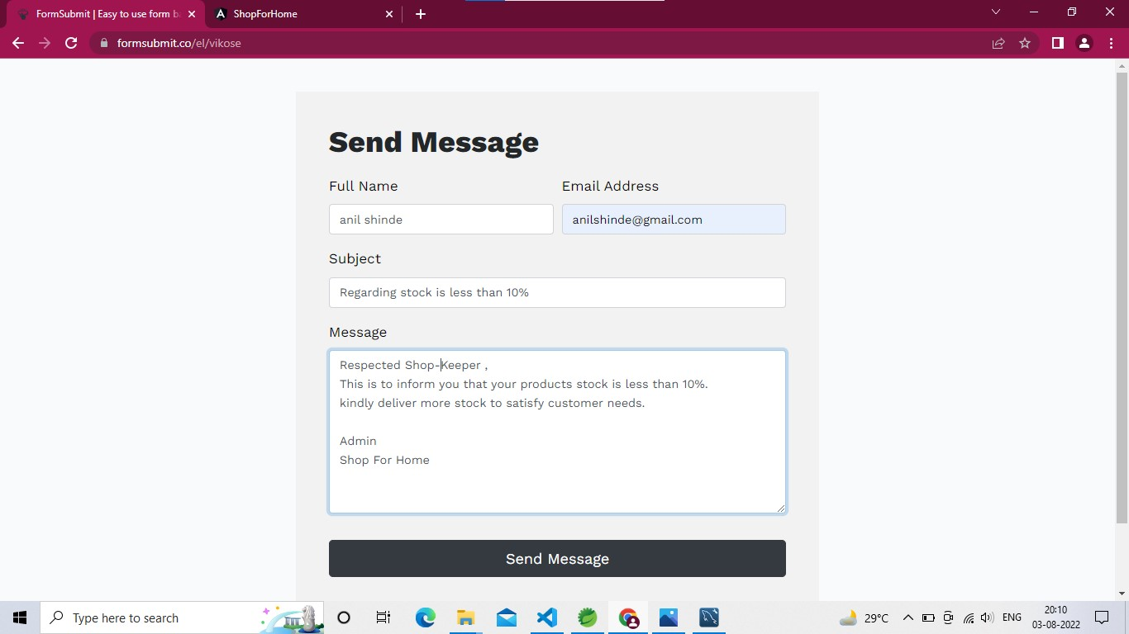
Admin Interface
Mail when stock < 10%

Slide 53
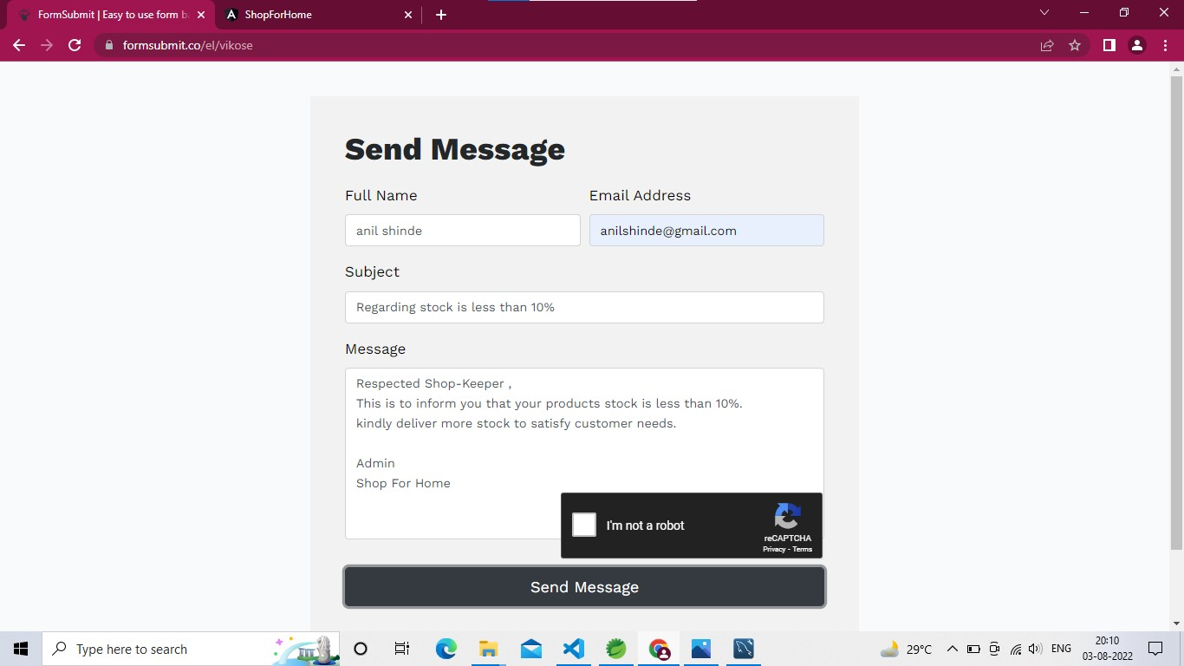
Admin Interface
Mail when stock < 10%

Slide 54
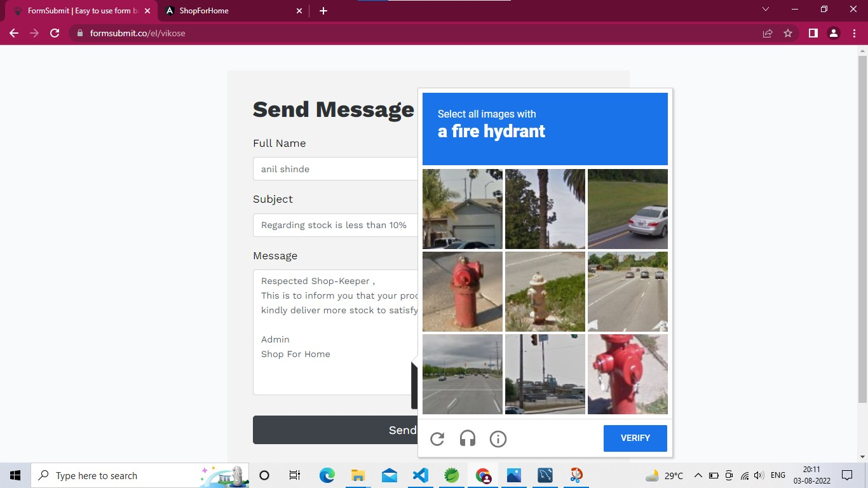
Admin Interface
Mail when stock < 10%

Slide 55
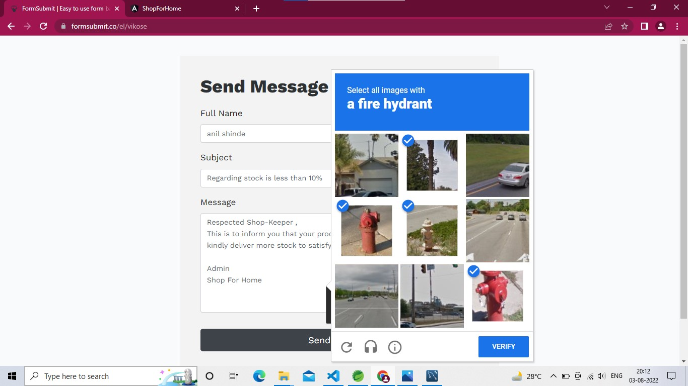
Admin Interface
Mail when stock < 10%

Slide 56
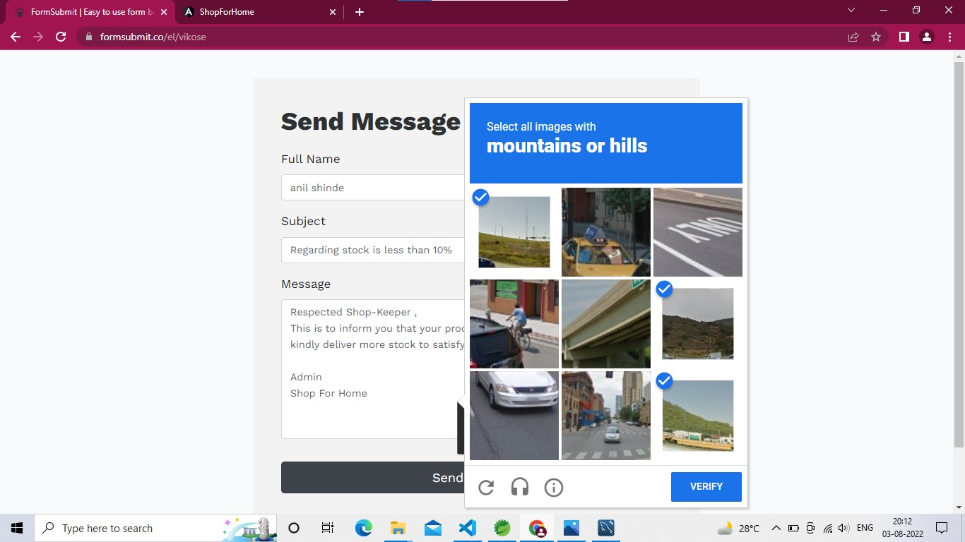
Admin Interface
Mail when stock < 10%

Slide 57
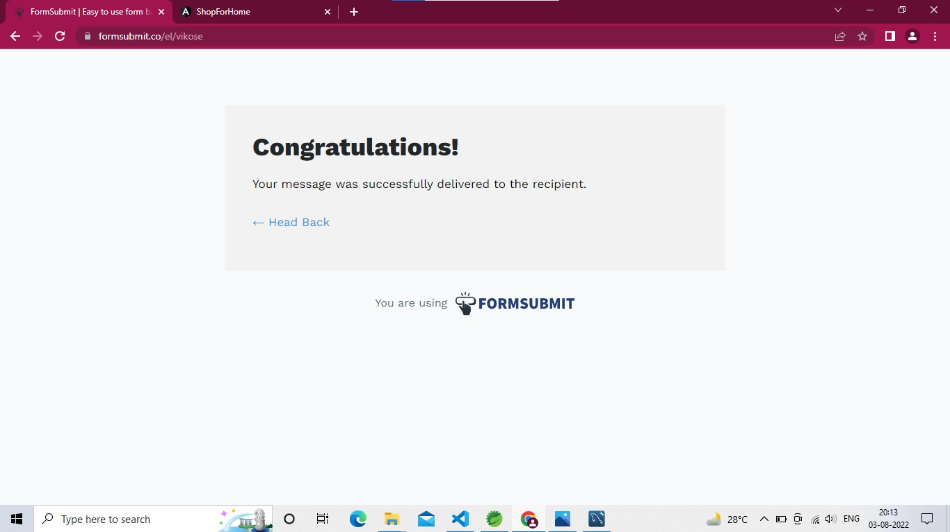
Admin Interface
Mail when stock < 10%

Slide 58

Admin Interface
Mail Recived

Slide 59

AWS Deployment of Project

Slide 60

AWS Deployment of Project

Slide 61

AWS Deployment of Project

Slide 62

AWS Deployment of Project

Slide 63

AWS Deployment of Project

Slide 64

AWS Deployment of Project

Slide 65

AWS Deployment of Project

Slide 66
Conclusion
We have created a Shop For Home JAVA-AWS core application using the Angular, Spring Boot and AWS (EC2 Instances, Load Balancer, Auto Scaling, S3), MySQL database. Hence, we are successful in deploying the application with all the requirements mentioned in the given problem statement

Slide 67
THANK YOU
Have A Good Day Ahead!

